Slide 1
Review of
Legislative Session
2017
David Johnson
General Counsel
Central Arkansas Water
Stuart Jackson
Wright, Lindsey & Jennings

Slide 2
Two broad topics:
1.
Water and wastewater legislation
2. Miscellaneous legislation

Slide 3
Water and wastewater legislation
92 “water” bills
47 “water” acts
16 “wastewater” bills
9 “wastewater” acts

Slide 4
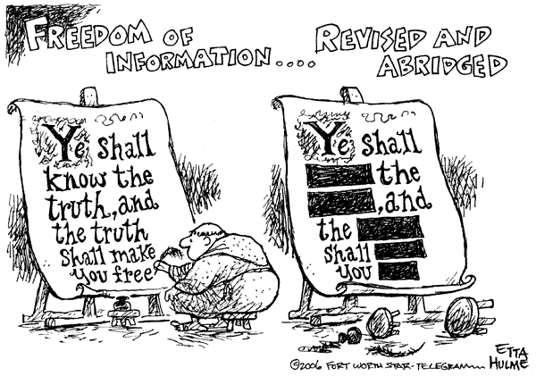
Freedom of Information Act – Customer Personal Information
2015:

Slide 5
Freedom of Information Act – Customer Personal Information
Customer
Customer’s attorney, guardian, etc.
Water system’s billing partners
EFFECTIVE DATE: IMMEDIATELY
2017:
Water system’s billing vendor
Tenant of customer
Research

Slide 6
Package Plants
Focus: Shore up nonmunicipal wastewater system trust fund
Additional step: Beefed up ADEQ enforcement against noncompliant providers
Water system role: No new service in provider service area
EFFECTIVE DATE: JULY 30, 2017
Notes:
Basically, nonmunicipal wastewater systems are typically private systems package plants that may serve small developments. In 2015, a trust fund was set up to shore up insolvent systems, but there was inadequate funding to keep it going. So legislation was passed this session to increase contributions AND that would give ADEQ an additional enforcement tool with the help of a water system or water systems that serves that nonmunicipal wastewater system’s service area. Water system must comply if it receives “signed statement” from ADEQ.

Slide 7
Design-Build
Additional procurement option for municipal sewage system
Design and construction services are provided by a single entity
Project minimum: $2 million
EFFECTIVE DATE: JULY 30, 2017
Notes:
Act 627 / HB 1645

Slide 8
Water Task Force

Slide 9
Water Task Force
Members:
Governor appointees
AWW&WEA representative
Legislators
AWWMA representative
Legislative appointees
ARWA representative
ANRC representative
Etc.
Report date: January 1, 2019
Notes:
AWWMA – Arkansas Water and Wastewater Management Association
ARWA – Arkansas Rural Water Association

Slide 10
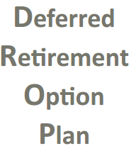
DROP – Returning to Work
Repeals prohibition against DROP participant’s future employment in position covered by Arkansas public retirement systems
Still cannot return to same position
Question about applicability to current DROP participants
EFFECTIVE DATE: JANUARY 1, 2018
Notes:
The state of the law regarding APERS and DROP have been a pretty fluid situation since the double-dipping story hit the front page of the Democrat-Gazette several years ago (Summer 2009 with first legislation in 2011). Existing law when the legislative session began provided that, when any APERS member ceases participation in DROP, the member was no longer eligible for employment in a position covered by a public retirement system in Arkansas including APERS.

Slide 11
CONCEALED CARRY
Guns in Private Employer Parking Lots
1
*
Guns in Public Buildings
2
*still okay to post
1
EFFECTIVE DATE: JULY 30, 2017
EFFECTIVE DATE: SEPTEMBER 1, 2017
2
Notes:
As for public parking lots, Arkansas Code § 5-73-306(18)(B)(ii) limits qualified vehicle to the employee’s vehicle and does not include a vehicle owned by another person that the employee may be driving such as the employee’s employer’s vehicle.
Bill – SB 37 – says that handgun must be stored in “personal handgun storage container.”

Slide 12
Issue 3 (2016)
Permits funding of “economic development services”
Requirements:
1. Procurement laws followed
2. Contract
3. State public purpose (e.g. “job creation”)
4. Not exceed one year in length
5. Performance indicators
6. Approval of governing body
Notes:
Act 685

Slide 13
Issue 3 (2016)
Permits funding of “economic development projects”
Requirements:
1. Procurement laws followed
2. Cost-benefit analysis for grants > $100,000
3. Contract
4. State public purpose (e.g. “job creation”)
5. Not exceed one year in length
6. Performance indicators w/ clawback provision
7. Approval of governing body
EFFECTIVE DATE: JULY 30, 2017
Notes:
Issue 3 = Amendment 97

Slide 14
Bills at the legislature that did NOT pass:
PVC
Eminent domain
SB 35
Fluoride I (Ladyman)
Fluoride II (King)

